Slide 1

Major Project (KCA451) Even Semester Session 2024-25
CODEX
SUMIT SAGAR - 2300290140186
VIVEK NEHRA - 2300290140208
VIKHYAT GARG – 2300290140201
SUMIT SINGH RAWAT – 2300290140188
Project Supervisor:
Mr. RITESH KUMAR GUPTA
ASSISTANT PROFESSOR

Slide 2
Content
Introduction
Literature Review
Objective of the Project
Technology
Hardware Requirements
Software Requirements
Modules
Workflow
Reports
References
Notes:
Font Styles: Times New Roman + Font Size: 25

Slide 3
Introduction
Codex is a simple, web-based platform aimed at providing real-time coding collaboration.
It offers a minimalistic user interface to facilitate peer-to-peer collaboration in a distraction-free environment.
The platform aligns with SDG 4 (Quality Education), making coding education accessible to diverse learners.
Codex focuses on promoting problem-solving, critical thinking, and teamwork through collaboration.
It requires no advanced setup, making it ideal for learners with basic internet access and devices.
Notes:
Font Styles: Times New Roman + Font Size: 25

Slide 4
Literature Review
Peer-to-peer learning is highly effective in coding education, enhancing student engagement, problem-solving abilities, and concept retention.
Collaborative learning environments allow students to teach each other, improving their understanding of coding principles and fostering teamwork.
Research by Guo (2013) highlights that students in collaborative settings show significant improvement in problem-solving and coding skills.
Codex is built on the idea of peer collaboration, providing a streamlined platform that eliminates distractions from unnecessary features.
Notes:
Font Styles: Times New Roman + Font Size: 25

Slide 5
Literature Review (Contd.)
Minimalistic design enhances learning by allowing users to focus solely on coding, leading to better engagement and performance (Brown & Peterson, 2021).
Unlike complex platforms such as GitHub and Visual Studio Code, Codex offers simple tools tailored to beginners and intermediate coders.
Existing tools like Slack and Google Docs offer collaboration, but they are not optimized for coding-specific tasks, which Codex simplifies.
Minimalistic UI principles (Nielsen’s Usability Heuristics) help reduce cognitive load, improving user satisfaction and engagement during the learning process.
Notes:
Font Styles: Times New Roman + Font Size: 25

Slide 6
Objective of the Project
Codex aims to facilitate real-time peer-to-peer collaboration, helping users solve coding challenges together.
01
It provides a minimalistic, easy-to-use interface, lowering the barrier for beginners..
02
Codex promotes peer learning, where users can review each other’s work and provide feedback.
03
The platform supports SDG 4 (Quality Education) by being accessible to learners from diverse backgrounds
04
Notes:
Font Styles: Times New Roman + Font Size: 25

Slide 7
Technology (Hardware Requirements)
User Devices: A desktop or laptop with at least 4 GB RAM and a dual-core processor for optimal performance.
Internet Connection: A stable internet connection with a minimum speed of 5 Mbps is recommended for smooth real-time collaboration.
Storage: At least 500 MB of free storage is suggested for caching and temporary files during extended sessions.
Cross-device Support: While optimized for desktops, Codex can also be accessed via tablets or mobile devices with limited functionality.
Notes:
Font Styles: Times New Roman + Font Size: 25

Slide 8
Technology (Software Requirements)
Frontend Technologies: Codex uses React.js for building an interactive, responsive user interface.
Backend Technologies: The backend is developed with Node.js and Express.js, ensuring efficient handling of API requests.
Real-Time Collaboration: Socket.io enables real-time communication, allowing users to collaborate simultaneously on the same codebase.
API Integration: Piston is used for executing code, while Codemirror provides in browser code editor syntax highlighting.
Notes:
Font Styles: Times New Roman + Font Size: 25

Slide 9
Modules
1.Real-Time Collaboration Module
This module handles the core functionality of real-time coding collaboration, enabling multiple users to work on the same codebase simultaneously using Socket.io for live updates.
2.Code Editor Module
A lightweight code editor built with React.js for users to write and review code. It includes syntax highlighting and basic code formatting tools, ensuring a smooth coding experience.
Notes:
Font Styles: Times New Roman + Font Size: 25

Slide 10
Modules
3.Room Management Module
Allows users to create or join rooms using a unique Room ID for collaborative coding sessions.
4.Code Execution Module
Enables users to execute their code and see the output in real time , supporting multiple programming languages.
Notes:
Font Styles: Times New Roman + Font Size: 25

Slide 11
Modules
5.User Management & Authentication Module Module
This module manages user authentication using Bcrypt, JWT tokens from express.js, allowing users to securely log in, create sessions, and collaborate with others.
6.Saved Code Module
Enables users to save code snippets in the backend, accessible later via a unique Room ID.
Notes:
Font Styles: Times New Roman + Font Size: 25

Slide 12
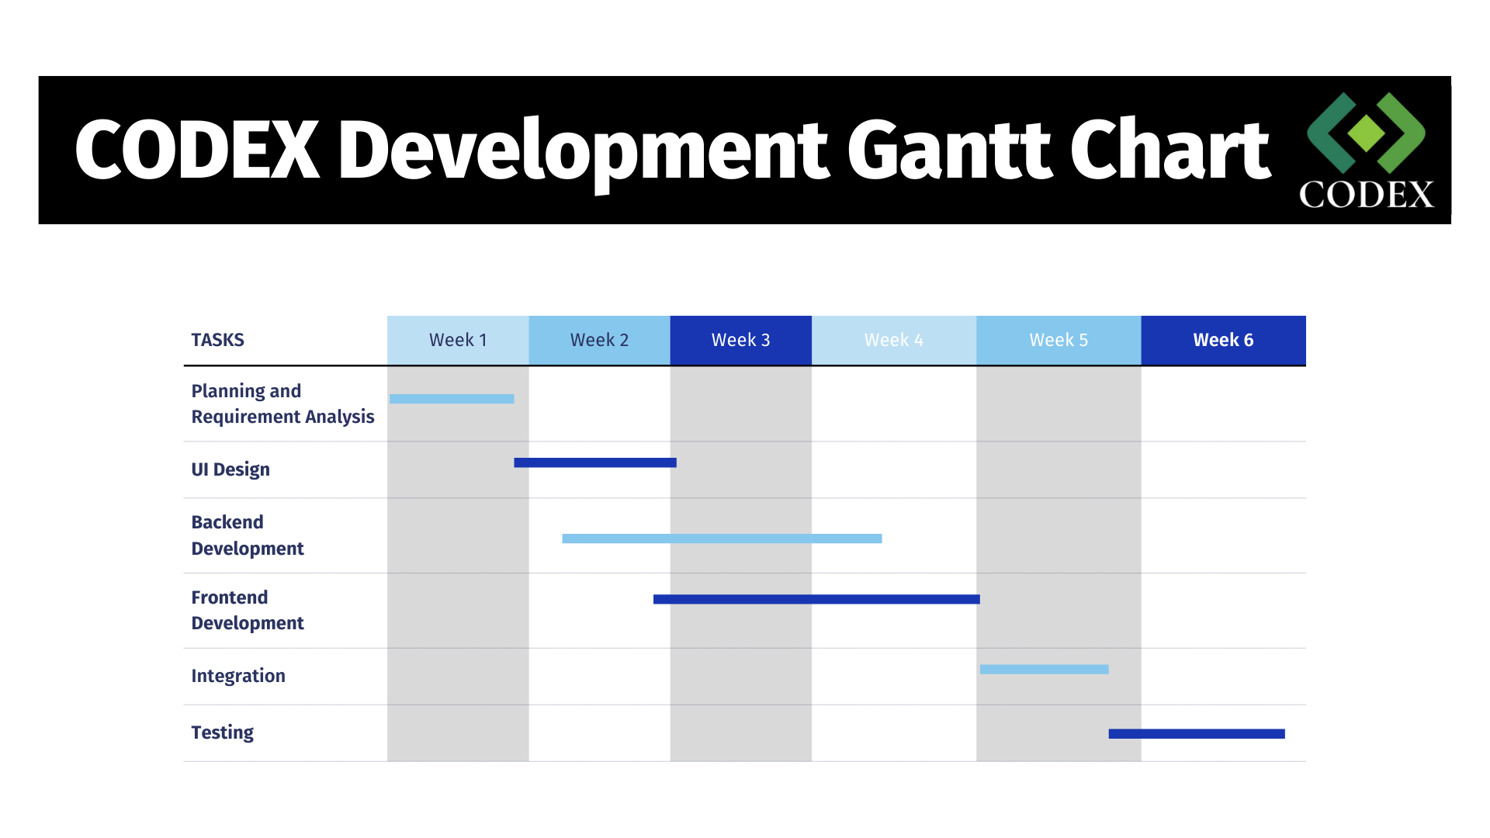
Workflow/Gantt Chart
Weeks 1-2: Conduct requirement analysis and design the user interface.
Weeks 3-4: Develop the backend with Node.js and Express.js and frontend with React.js.
Weeks 5-6: Perform testing of the project.
Notes:
Font Styles: Times New Roman + Font Size: 25

Slide 13
Reports
1. Code Execution Report
This report details the languages supported, execution times, and success/failure status of code run through the Piston API.
2. User Activity Report
This report summarizes user engagement within the collaborative coding environment, including the number of users, code changes, and real-time interactions.
3. Performance Report
Analyzes the overall performance of the system, focusing on server response times, code execution latencies, and the efficiency of real-time updates.
Notes:
Font Styles: Times New Roman + Font Size: 25

Slide 14
References
United Nations. (2023). Sustainable Development Goal 4: Quality Education. United Nations Department of Economic and Social Affairs. Retrieved from https://sdgs.un.org/goals/goal4
The WebSocket Protocol.
for Collaborative Coding Platforms. RFC 6455: The WebSocket Protocol. Retrived from IETF WebSocket Protocol
MDN Web Docs.
The Important features of various technologies. Retrieved from https://developer.mozilla.org/
Notes:
Font Styles: Times New Roman + Font Size: 25

